Slide 1
Understanding Swap Spreads
November 2015

Slide 2
DEFINITIONS AND KEY CONCEPTS
Swap Spreads
Swaps and bonds have the same type of market risk. They differ markedly in terms of liquidity and credit risk.
Swaps contain the credit risk embedded in the LIBOR index on the floating leg and, potentially, counterparty default risk.
Liquidity has separate drivers in the Swap and Treasury markets. Moreover, Treasuries perform a collection of unique functions in financial markets that give them a status very close to cash.
The difference between the yield of an interest rate swap and the yield on a Treasury of the same maturity
Components of a Swap Spread
Counterparty Default Risk: Considered to be minimal because of credit risk-mitigation (mark-to-market, collateralization, termination options for long-dated swaps). However, as the Lehman bankruptcy demonstrated, re-establishing positions previously held with a now defaulted counterparty may be expensive, esp. if the counterparty is a significant market participant.
Liquidity Risk: Treasuries are preferred instruments, Treasuries offer access to cheap repo (usually)
Credit Risk: The credit spread in swap rates originates from the stream of LIBOR-indexed payments on the floating leg. LIBOR itself is a short-term and default-risk-embedded interbank lending rate. There is no idiosyncratic risk associated with a swap (unlike a bond) and swap spreads serve as a gauge of systemic risk.
Funding Risk: Availability of repo, stability of repo haircuts, repo “specialness,” ability to rollover repo

Slide 3

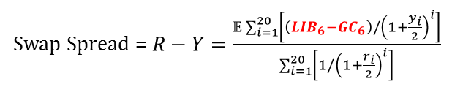
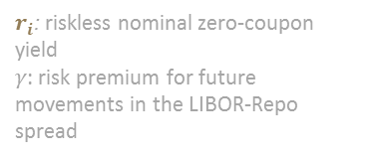

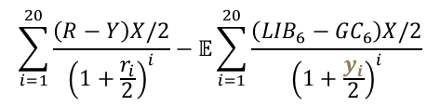
DETERMINANTS OF THE SWAP SPREAD: THEORY
The theoretical calculation for swap spreads demonstrates that the fair value of the swap spread is a direct function of expectations of the future spread between 6-month LIBOR and 6-month repo.
Assumptions:
It costs nothing to short a bond – in practice, bonds can go “special” in the repo market.
There is no counterparty default risk in the swap (this allows us to use the risk-free yield to discount the fixed cash flows)
1
Stylized trade
Short $X of 10-year government bond at par and yielding Y
Invest the proceeds in 6m GC repo and roll over at each 6m over 10 years
Simultaneously enter a 10-year swap contract to receive fixed/pay 6m LIBOR at current swap rate R on an $X mm notional principal
2
Semi-annual cash-flows for trade (over 10 year life of the bond)
$$\left[\frac{R−Y}{2}−\frac{{LIB}_{6}−{GC}_{6}}{2}\right]×X$$
3
Present value at initiation
$$\sum_{i=1}^{20}{\frac{\left(R−Y\right)X/2}{{\left(1+\frac{r_{i}}{2}\right)}^{i}}}−𝔼\sum_{i=1}^{20}{\frac{\left({LIB}_{6}−{GC}_{6}\right)X/2}{{\left(1+\frac{y_{i}}{2}\right)}^{i}}}$$
$y_{i}=r_{i}+γ$
$r_{i}$: riskless nominal zero-coupon yield
$γ$: risk premium for future movements in the LIBOR-Repo spread
4
Swap Spread
If both the government bond and swap markets are fairly valued
Swap Spread = $R−Y=\frac{𝔼\sum_{i=1}^{20}{\left[\left({LIB}_{6}−{GC}_{6}\right)/{\left(1+\frac{y_{i}}{2}\right)}^{i}\right]}}{\sum_{i=1}^{20}{\left[1/{\left(1+\frac{r_{i}}{2}\right)}^{i}\right]}}$
If risk premium $γ$ = 0, then the fair swap spread is the weighted average of the future expectation of this spread.

Slide 4
HISTORICAL EVOLUTION AND DETERMINANTS OF SWAP SPREADS
1994-1997: Swap-spread levels and volatilities were relatively low.
July 1997: Asian crisis leads to credit risk concerns
August 1998: Russian crisis and the near collapse of LTCM spark flight-to-quality
Mid-1999-2000: Swaps spreads were kept high by concerns about potential Y2K disruptions.
2000: Swap spreads widen because of large UST buybacks
2001-2003: Fed rate cuts and fiscal surpluses giving way to deficits
Early August 2003: MBS Convexity Hedging
2007-2009: Financial crisis leads to wider swap spreads with flight-to-quality
2009-2015: Deficit of risk (equity) capital + greater focus on (repo) counterparty risk + higher haircuts + higher repo rates
August 2015-Present: Foreign selling of UST, bloated dealer balance-sheets, increasing debt issuance by FIs, reevaluation of duration hedges, stop-outs
HISTORY OF THE 10-YEAR SWAP SPREAD
(January 1994 – November 2015)
Y2K liquidity
1998 Russia Default and LTCM crisis
Financial crisis
Post-crisis restrictions in debt markets
1997 Asia Crisis
Technical factors
Source: Citigroup

Slide 5
EMPIRICAL DETERMINANTS OF SWAP SPREADS
The following factors all show some correlation with swap spreads. They can be decomposed into fundamental factors (Carry/funding effect, Systemic risk) and technical factors (Treasury-specific factors, supply/demand effects).
None of these factors necessarily account for the impact of new regulatory frameworks such as Dodd-Frank, Basel 3 RWA, LCR, Supplementary Leverage Ratio, Mandatory Swaps Clearing etc.
Factor | Comments
Treasury Supply | Dynamics of fiscal deficit and government debt
AA Credit Spreads | Changing perceptions of credit risk over the long term, particularly in the AA-rated sector, as the majority of banks quoting LIBOR rates are AA-rated
On-Off-the-Run Treasury Bond Yield Differential | The difference in yield between on-the-run and off-the-run Treasuries constitutes an indication of the “liquidity convenience yield”
Slope of the Yield Curve | Swap spreads tighten as the yield curve gets steeper and vice-versa: in steep yield curve environments the cost of funding long-dated fixed-rate liabilities increases
LIBOR-Repo Spread | Captures the LIBOR credit spread and the liquidity premium stemming from the ability to fund Treasuries in the repo market
MBS Duration | Swaps spreads tighten as mortgage rates decrease (duration buybacks) and vice-versa
Volatility of the Stock Index | Stock market volatility is good indicator of the overall risk aversion in the capital markets

Slide 6
SHORT-END SWAP SPREADS: STRONG LINK TO LIBOR-REPO SPREADS
Theory argues that swap spreads should reflect the expected values of the LIBOR-Repo spread over the term of the swap. The theory should hold more weight for short-end spreads where the holding periods are shorter.
In practice, several technical factors affect the swap spread and have a more pronounced effect in one regime compared to another.
For example, 2-year swap spreads widened materially relative to the LIBOR-Repo spread in the middle of 2014 because of various technical reasons including lower short-maturity Treasury issuance, money market reform, and expectations of a wider reverse repo program/interest on excess reserves band.
More recently, the swap spread has plunged due to balance sheet pressures faced by FIs.
THE 2-YEAR SWAP SPREAD vs LIBOR-REPO Spread
(February 2011 – November 2015)
Source: Morgan Stanley, Cello

Slide 7
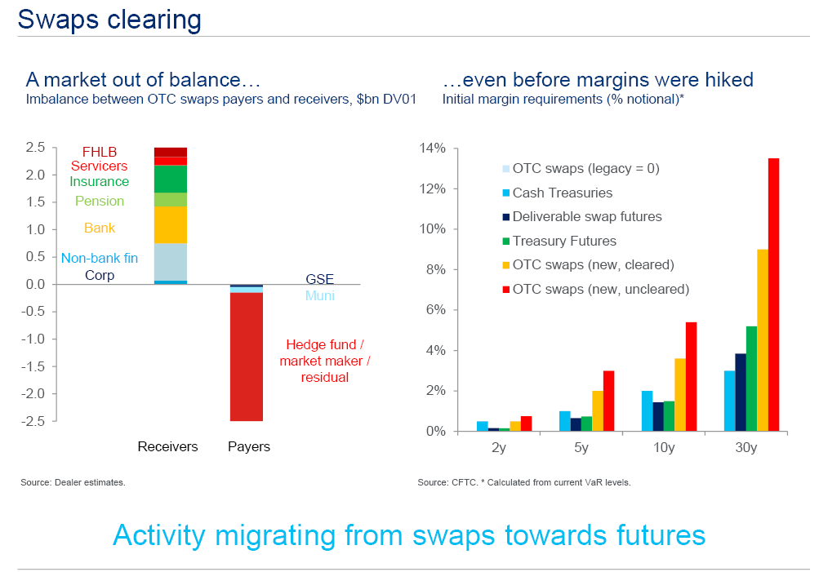
LONG-END SWAP SPREADS: STRONG LINK TO MARKET STRUCTURE & PARTICIPANTS
There are plenty of natural and very large receivers in the swap market. There is no natural payer that matches the receivers in size.
Accounts that need short term duration hedges against other cash products have turned to listed Treasury Futures instead of Swaps because of lower initial margin costs and swap spread behavior.
CHANGES IN SWAP CLEARING
Source: US Treasury (July 2013)

Slide 8
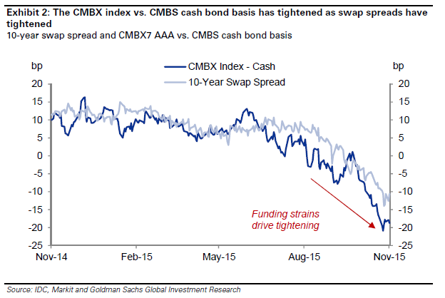
BALANCE SHEET PRESSURES ARE ALSO DRIVING OTHER MARKETS
The recent swap spread tightening can also be seen in other asset classes such as CMBS or corporate credit. The general underperformance of cash products versus synthetic products is indicative of how funding pressures are an important driver of recent swap spread tightening.
SYNTHETIC vs CASH BASIS: CMBS
(November 2014 – November 2015)
Source: Goldman Sachs

Slide 9
LIMITS OF Swap Spread Arbitrage = NEGATIVE SWAP SPREADS
A swap spread arbitrage trade may need to be held until maturity consuming balance sheet and relies fundamentally on the smooth functioning of repo markets.
Specifically, swap spread arbitrage requires (1) stable levels of risk capital, (2) the ability to obtain repo (or some other source of financing), and (3) stable repo haircuts and financing rates (for financing the Treasury side of the trade).
A negative swap spread may thus be fair compensation for assuming repo refinancing risk over a long term.
There is no intrinsic contradiction in GC Repo (collateralized) trading above LIBOR (uncollateralized) – they reflect rates applicable to different sets of borrowers.
30-Year Treasury Purchase
Receive 3.02% p.a. for the next 30 years
Pay 1-month repo, rolled every 1 month, to finance the purchase
30-Year Swap Trade
Pay 2.53% p.a. for next 30 years
Receive 1-month LIBOR rate, reset every 1 month, for next 30 years
Net Cash Flow: Long 30-Year Treasury & Pay 30-Year Fixed
Fixed-rate differential = Treasury Rate – Swap Rate ≈ 49 bps
Floating-rate differential = LIBOR – Repo ≈ -5bps
Risks
Duration: Limited to none
Mark-to-market: Swap spreads tighten/widen -> MTM Loss/Gain
LIBOR-Repo Spread: Spreads widen/tighten -> Carry increases/decreases
Balance Sheet: Haircuts increase/decrease -> Trade ROE decreases/increases; Liquidity decreases/increases
Source: Citigroup, Cello. As of 11/20/2015.

Slide 10
DISCLOSURES Important Notes
THIS DOCUMENT IS NOT AN OFFER TO SELL OR THE SOLICITATION OF AN OFFER TO BUY SHARES OF THE FUND. AN OFFERING OF INTERESTS WILL BE MADE ONLY BY MEANS OF A CONFIDENTIAL PRIVATE PLACEMENT MEMORANDUM AND ONLY TO QUALIFIED INVESTORS IN JURISDICTIONS WHERE PERMITTED BY LAW. PAST PERFORMANCE IS NO GUARANTEE OF FUTURE PERFORMANCE.
An investment in the Fund is speculative and involves a high degree of risk. The Fund will have substantial limitations on investors’ ability to redeem or transfer their shares, and no secondary market for the Fund’s shares exists or will develop. All of these risks, and other important risks, are described in detail in the Fund’s Confidential Private Placement Memorandum. Prospective investors are strongly urged to review this Confidential Private Placement Memorandum carefully and consult with their own financial, legal and tax advisors, before investing.
Portions of this document may contain commentary and/or data based on certain current assumptions by Cello Capital Management, LP(“Cello”), which are subject to change at any time, as well as Cello's internal complex calculations. If one or more of these assumptions or calculations is incorrect, the information contained herein may unintentionally be inaccurate.
Certain information contained herein may have been obtained by Cello from third parties. While Cello believes such sources are reliable, Cello has not verified the accuracy of such information and shall not be liable for any errors in such information or for any actions taken in reliance thereon.
Performance results referenced in this document are provided for an investor in Class A1a shares of Cello Fixed Income Master Fund, LP (the “Master Fund”). Unless otherwise noted. Performance reflects all income. Class A1a shares launched on January 1, 2012, and returns for periods prior thereto have been adjusted to reflect the management fees and performance allocations chargeable to Class A1a shares.
The Credit Suisse Fixed Income Arbitrage Hedge Fund Index is a subset of the Credit Suisse Hedge Fund Index that measures the aggregate performance of fixed income arbitrage funds. The Fixed Income Arb Index, which includes mortgage-backed securities, is part of Dow Jones Credit Suisse Hedge Fund Index. The Barclays U.S. Aggregate Index represents securities that are SEC-registered, taxable, and dollar denominated. The index covers the U.S. investment grade fixed rate bond market, with index components for government and corporate securities, mortgage pass-through securities, and asset-backed securities. The Credit Suisse All Hedge Index is an asset-weighted hedge fund index. The S&P 500 is an equity index based on the market capitalizations of 500 large US companies.
This document may also contain certain forward looking statements and projections. Such statements and projections are subject to a number of assumptions, risks and uncertainties which may cause actual results, performance or achievements to be materially different from future results, performance or achievements expressed or implied by these forward-looking statements and projections. Prospective investors are cautioned not to invest based on these forward-looking statements and projections.
This document may contain references to certain internal Cello procedures and policies which are subject to change at any time.
No information or material contained herein may be reproduced, transmitted, displayed or commercially exploited without the prior written consent of Cello. All rights are reserved.

